Slide 1
Developing school and public library partnerships: promoting ONE Access
By: Megan Northcote

Slide 2
Project goal
To raise awareness among William Amos Hough High School students of the resources and services available to them at all Charlotte Mecklenburg Public Library (CMPL) branches through their ONE Access account

Slide 3
What is ONE Access?
CMPL initiative launched this September
All 145,000 CMS students use their student ID number as their public library account number
Provides access to all CMPL resources and services

Slide 4
Project Objectives
To provide all William Amos Hough High School teachers with access to information about the ONE Access initiative, particularly the resources available to their students through the Davidson and Cornelius public libraries
To provide all Hough High School students with information about the ONE Access initiative, including awareness of all public library collection materials, online resources, and programs, especially those available at the Davidson and Cornelius public libraries
To teach all Hough High School English 11 students about the public library’s electronic databases available to assist them in completing their mandatory “pre-senior project” 11th grade research papers
To increase the number of Hough High School student users of the Cornelius and Davidson public libraries, both virtually and in-person
Notes:
Teaching and learning
Information access and delivery

Slide 5
1st implementation strategy and results
Create handouts for students and/or teachers outlining how ONE Access works and highlighting key resources and services at CMPL
Left brochures in media center and distributed handouts to English 11 classes
Observed some students taking the brochure

Slide 6
Brochure page 1

Slide 7
Brochure page 2

Slide 8
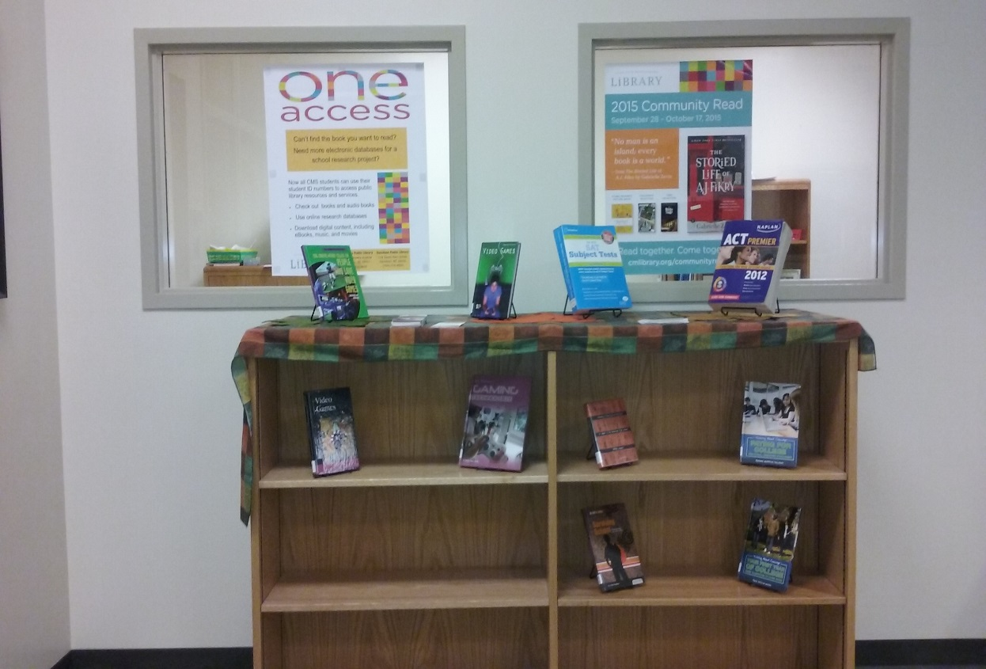
2nd implementation strategy and results
Create a display area in the high school media center designated to promoting CMPL programs and resources
Display remained up throughout the semester; rotated out different publicity materials
Didn’t really notice kids looking at it though…

Slide 9
3rd implementation strategy and results
Attend a Hough High School mandatory staff meeting and give teachers a brief overview presentation about ONE Access
At meeting, highlight the CMPL website, collection materials catalog, and electronic databases available to students
Results:
Staff meeting only held once a month at a time that was inconvenient with my schedule
probably wouldn’t have been too effective anyway

Slide 10
4th implementation strategy and results
Include information about ONE Access and a link to the CMPL website on the Hough High School media center page on the school’s website
Results:
Couldn’t accomplish this because the person in charge of updating the website has been unable to do so this semester due to some kind of technical problem…

Slide 11
5th implementation strategy
Goal was to lead 5-10 minute information instructional sessions in all 11th grade English classes
Educate students about ONE Access and CMPL resources
Specifically highlight the electronic databases helpful for completing their mandatory “pre-senior project” 11th grade research papers
Actually presented to 7 English classes for 15 minutes each

Slide 12
What I presented on in English classes
Catalog searching
Teen services page
Tutor.com
Demonstrated searches in electronic databases
NCLive
Ncpedia
Gale Virtual Reference Library
Lands and Peoples Online
PBS Video collection
ProQuest databases
Science in Context
World Book Encyclopedia

Slide 13
5th implementation strategy results
Teachers said they would post links to my databases on their Google Classrooms, but no one did
Teachers said they would offer extra credit for citing CMPL in research papers
Observed some students pick up a copy of the handout I created for them
Distributed surveys for each class in teacher’s mailboxes with instructions to return to media center within 3 days
Of the 200 surveys distributed, 85 were returned and 70 were filled out

Slide 14
Survey results
70 completed surveys
Surveys compared student usage of physical and virtual public library before and after hearing me speak in their classrooms

Slide 15
Physical library survey results
38 – no change in library visitation
33 of those never visited library and 10 of those visited the library 1-3 times before and after presentation
17 – decrease in library visitation after presentation
7 – increase in library visitation after presentation
5 of these used for personal use, 2 of these for library database resources

Slide 16
Website survey results
44 – no change in website visitation
42 of those never visited website before or after presentation
9 of those visited website between 1-3 times before and after presentation
9 – visited same databases before and after presentation
ProQuest, NC Live, PBS video, Worldbook
5 – decrease in website visitation after presentation
7 –increase in website visitation after presentation
6 started using online databases
NC Live, Worldbook, ProQuest, PBS Live
3 –visited teen services page after presentation

Slide 17
Conclusions from survey results
Majority response = No change in physical or virtual library visitation
Maybe not enough time had elapsed for them to go
No need to visit - Students had already gotten much of their research underway by the time I presented to their classes
Greater decrease in visitation to physical library (17) versus virtually (5)
Maybe lack of transportation, busy schedules, etc.
7 person increase in visitation to physical and virtual library
Better than nothing, maybe they’ll tell their friends
ONE Access publicity materials still at media center and English 11 teachers
Teachers and media specialist needs to incentivize students to use CMPL

